Slide 1
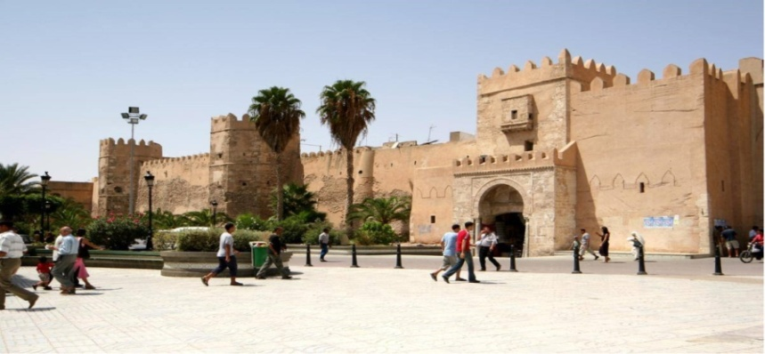
Summer school on Gender Studies / ERASMUS+ Project
16-20 october 2017
The use of Sfax city by gender : between social anchoring and inequeties in space practices / representation of the public and the private spheres via a cartographic analysis
Emna FRIKHA
PhD student in urban sociology (Univ. of Tunis)
E-mail: frikha.emna13@gmail.com

Slide 2
In general, in Maghrebine societies, the private space is relative to family, home, domestic space where women assert themselves by motherhood power while public space is invaded by male domination. Men and women do not have the same frequentation of public and residential spaces. These disparities induce an exclusion of women from the public sphere.

Slide 3
Research’s general context
The aim of this research is to highlight the link between social anchoring and unequal spatial practices by men and women in public and private spaces.

Slide 4
Hypothesises
The unequal space practices between men and women are conditioned by social censure and social time of Sfax city.
There is a mutation of some space practices from public sphere to the domestic sphere. We hypothesis that this is a mean of compensation for lack of a thriving cultural life.

Slide 5
Sfax is a coastal town and it is the second most influential town in Tunisia in terms of economical development and population (nearing 1 million inhabitants according the 2014 general census of population). Sfax is characterized by being an entrepreneurial and industrial city, in addition to being an educational and migratory pole.
The main trunk roads run in a radial pattern to the city's center. Beside the orthogonal fabric of the European part in city center, the urban landscape is affected by the Medina which thourghout history marked Sfax. The "Jnèns", a key element of the Sfaxian identity mark the landscape of the town. In general, a jnèn is a big fruit garden punctuated by familial habitations. By contrast, the urban sprawl continues to nibble away at the edge of the jnèns.

Slide 6
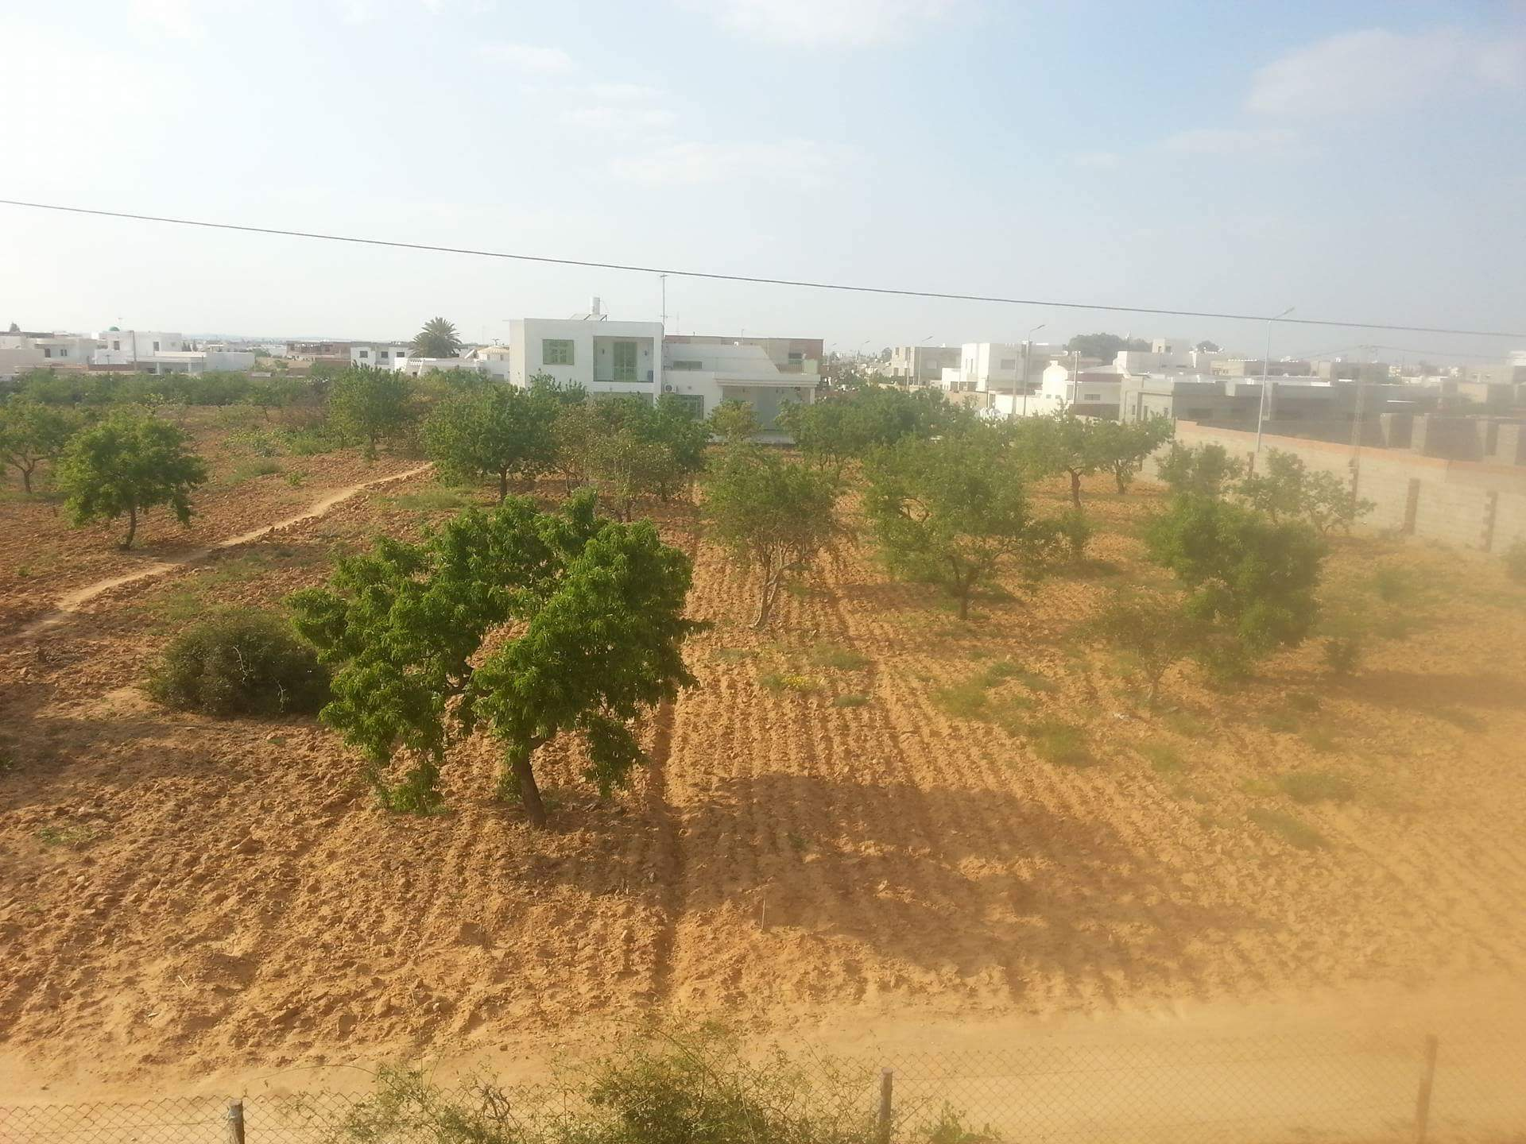
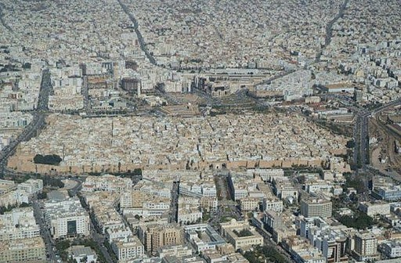
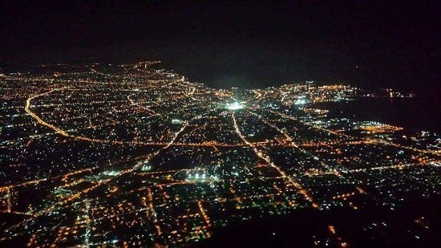
characteristics of the city of Sfax
Coastal town
Cultural life has declined
About 1 million inhabitants, INS 2014
Rare attendance of the city center by night
Entrepreupreunial and industrial city
Educational and migratory pole
Impact of social time in space practices
The main trunk roads run in a radial pattern to the city's center
family members tend to live in the same area
The Médina and the jnens: as specific urban entities

Slide 7
Socially speaking, family members tend to live in the same area. The social time of the city has an impact on the space practices especially for women. The attendance in the city center by night is rare and the cultural life has declined over the decades.

Slide 8
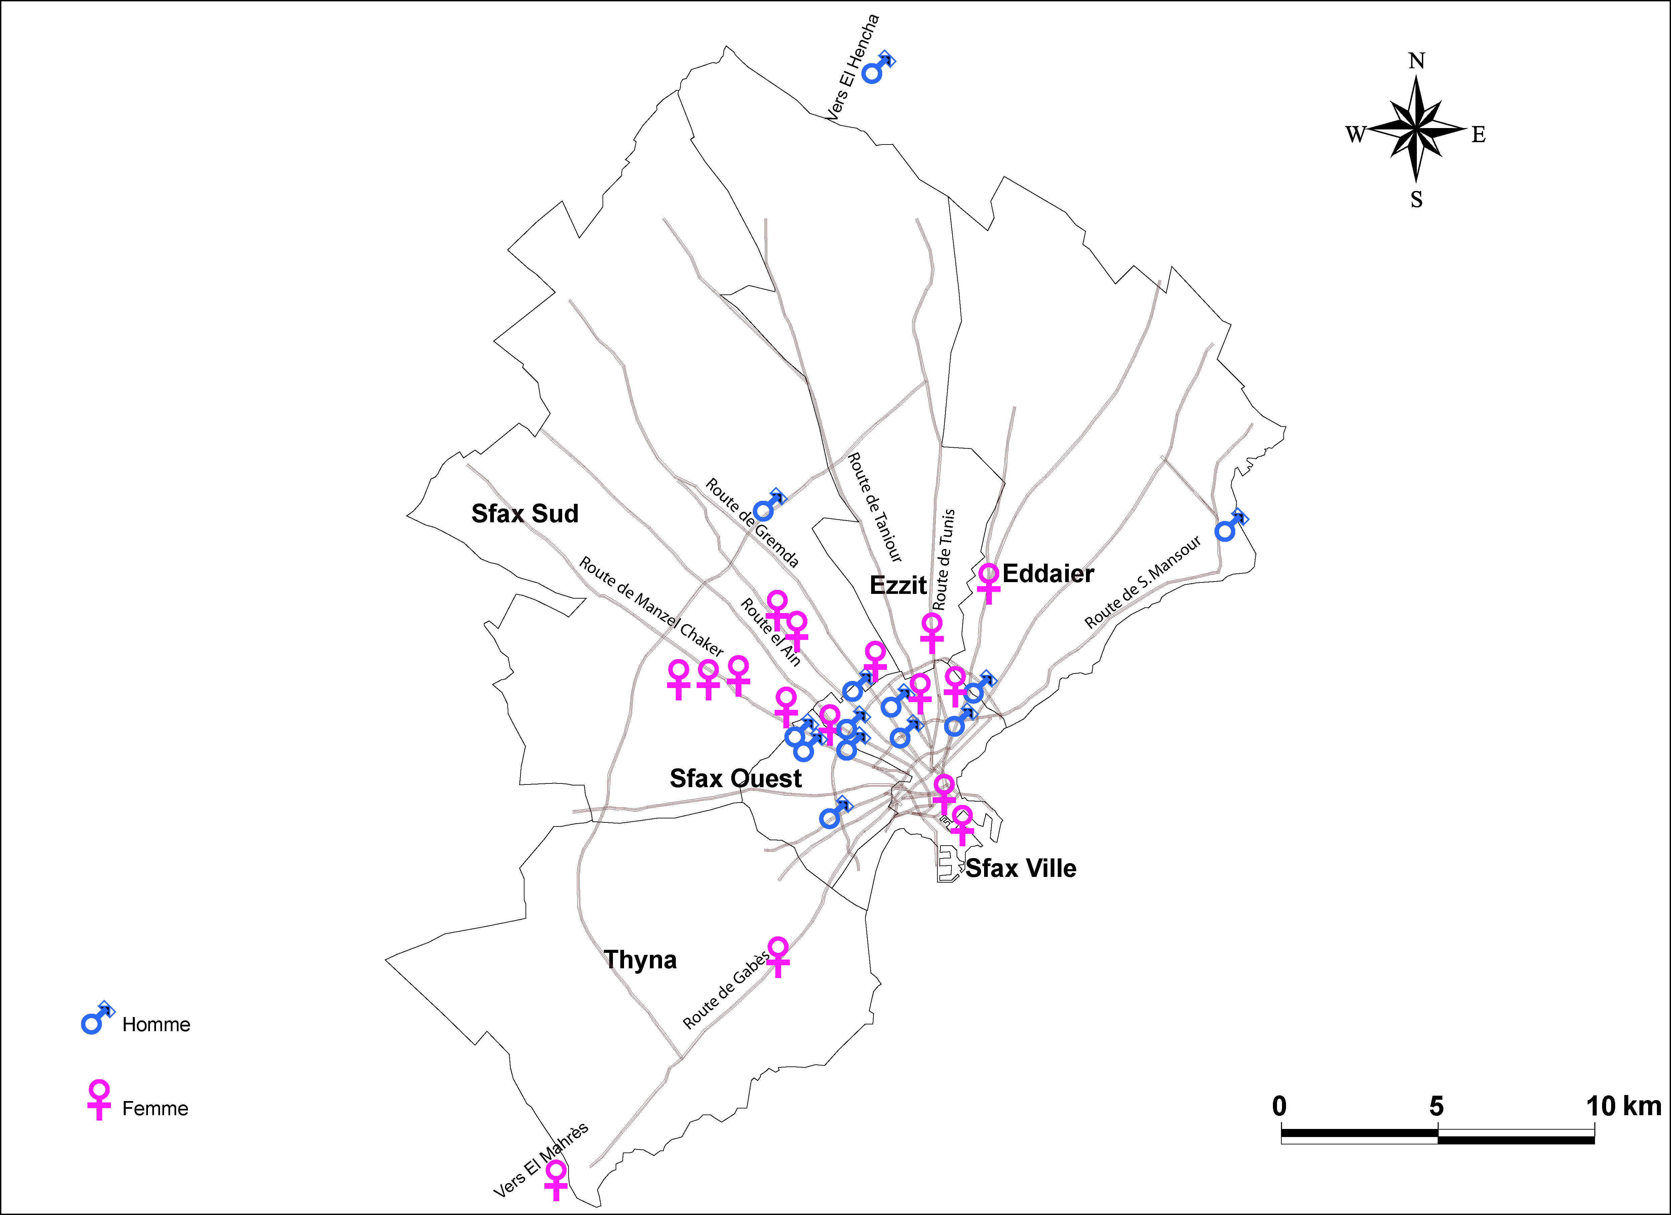
Followed Methodology
16♀,13♂
the
central area
various
Socio-economic backgrounds
the suburban area
The Jnèns

Slide 9
Our investigation consists in a semi-directive interview based on a sample of 16 women and 13 men living in Sfax. They have different social and economical characteristics and are localized between the central area, suburban area and the Jnèns area. Young people and females had demonstrated more enthusiasm to participate in this study.

Slide 10
The interview guide is based on the idea of space evolution: the traditional system consolidate the relegation of women in the private space, but modern architecture follows the emancipation of women by integrating the public space. So we begin our interview from a domestic sphere perception to arrive to public sphere practices. We notify that the emotions of the interviewed people is significant in spatial cognition and it is an undeniable part in the analysis.

Slide 11
Residential areas: mutation between the traditional & the modern system in sprawl area
MEGDICHE T, 2005

Slide 12
Results’s analysis is based on corpuses qualitative analysis by using the software (R.temis) and using Adobe Illustrator for map elaboration .

Slide 13
Domestic sphere perception
Public space practices
corpus qualitative analysis (R.temis)
map’s elaboration (Adobe Illustrator).

Slide 14
Results

Slide 15
The domestic sphere
The qualitative analysis shows that the domestic sphere is more recurrent than the public sphere in spatial cognition for men and women.
The domestic sphere
The private space, as perceived by men and women, is a familial and intimate space which provides freedom and mental comfort. The semantic analysis shows that many women appropriate their homes and insist that the access to it must be authorized; while they consider the public space as allowed for everybody. This analysis highlighted the fact that men tend to represent the private space as a closed space. Also they tend to limit their private space to their homes or their work place.

Slide 16
Unpaid work: infuenced by traditional values
Out of thirteen men, six answered that the kitchen is a female space, furtheromore; while most of these women have jobs and occupations, they still deeply internalize this same idea. But this does not rule out that in some of the answers depicted that unpaid work is fairly dispatched among all family members women and men alike.

Slide 17
The domisticated street
The domesticated street is not restricted to the familial home, it also includes the neighboring space, the neighborhood and childhood places, especially for men.
The patriarchal system does not often interfer with men when it comes to changing the resdiantial space after marriage. It is up,to the bride to uproot her comfort sphere and to adapt to her step family’s sphere.
Domesticated street | occurrence (%) | ♀ | ♂ | age | Area's localization
in front of my house | 31,25 | 7 | 3 | 15-60 ans | residantial area
childhood place | 28,12 | 3 | 6
others | 18,75 | 4 | 2
city center | 21,87 | 4 | 3 | >60 ans | central area

Slide 18
Spatial cognition of the neighbourhood in central area and jnens’s area

Slide 19
The women tend to represent the neighborhood in a circular form; meanwhile men represent it in a square form. Three major factors influence the perception of the neighborhood: marital status, gender and the place of residence.
In the jnèns’s area, for women, the neighborhood includes familial house, cousins, family and neighboring businesses. While, for men the neighborhood encompasses the familial house, roads, childhood places, neighbors and mosquees.

Slide 20
Densified neighborhood in the central area

Slide 21
The public sphere has been defined by interviewees as a meeting place frequented differently by men and women. It has also been defined as a space of interrelations ruled by social norms where people must behave correctly. During the survey, several people describe the public space in negative terms such as: overcrowded, polluted, disorganized and the notion that the city center is an urban heat island.

Slide 22
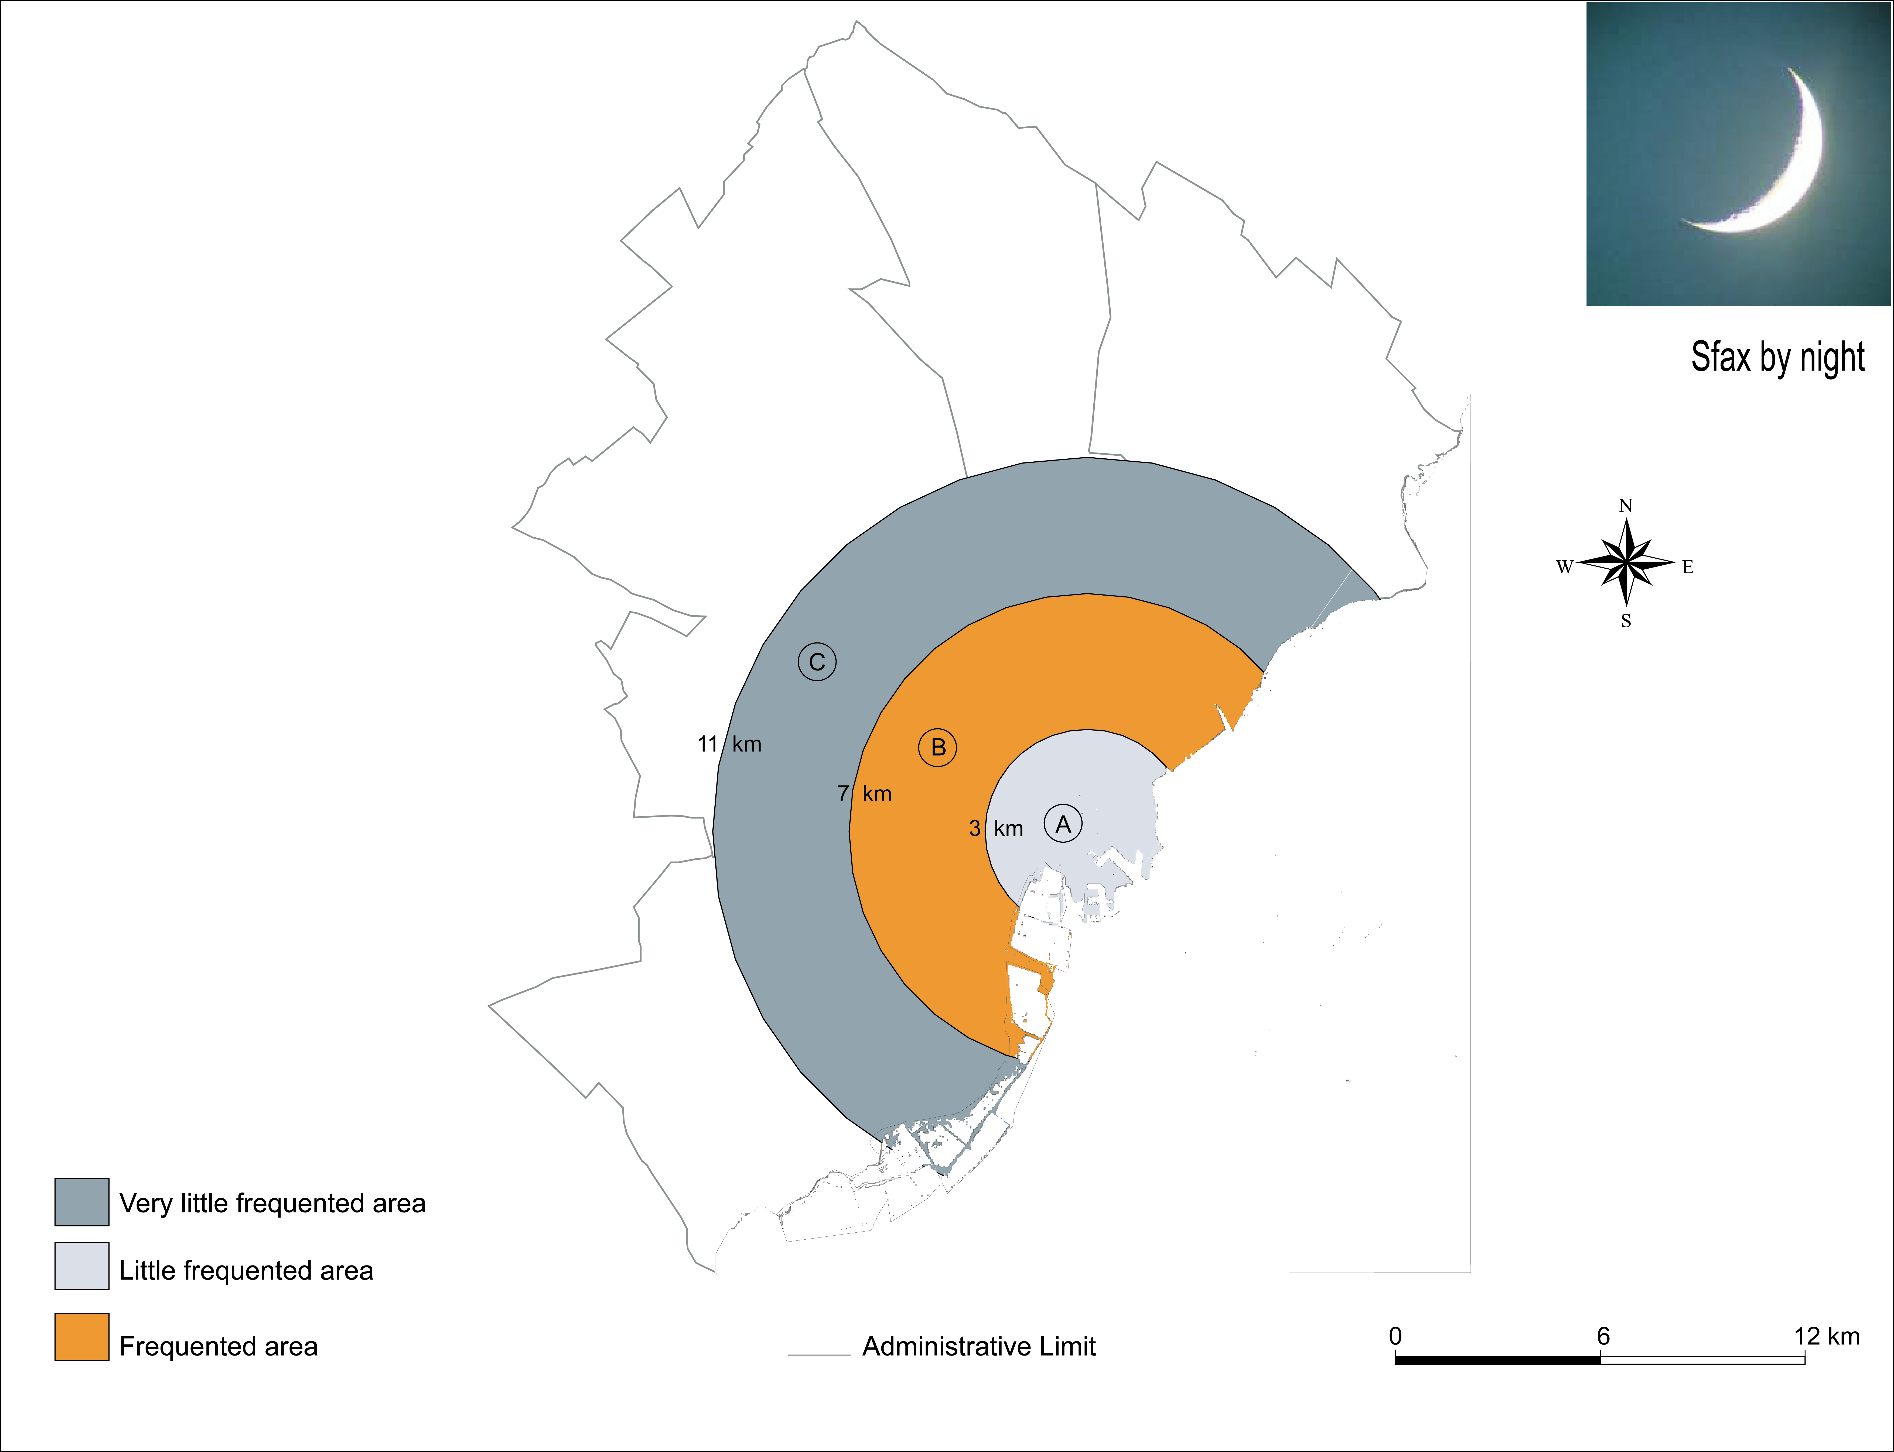
The Public sphere
Analysis results
Public spaces are unfit for serving gender equality.
lit areas
tea-houses
fast foods
The suburban area is more frequented than the central area

Slide 23
The attendance of city center significantly drops by night and becomes rare in the periphery area. The suburban fabric is frequented. In fact, we noticed that people gather around fast foods , restaurants, tea houses and lit areas in general.
By day, the city of Sfax is a dynamic and thriving town while decentralization has created a new dynamic along the main roads . center town has remained the converging place for city users. We deduce that the vocation of some places changes between day and night.

Slide 24
Dynamism of Sfax city by day-time: various densities in attendance

Slide 25
The defining factors in choosing the space practices in the public sphere
Attractivness and prohibition of different spaces
Personal feeling of security and insecurity
Personal perception of male and female spaces

Slide 26
Most interviewed women feel the security within their homes. Those of them who feel the safety within the Medina are already living there or has grown up with its walls.
By contrast, men appropriate all the city and many of them also appropriate their work place.

Slide 28
The Medina is more attractive for women than men. Based on our corpuses analysis we can claim that most parts of the Medina revolve about marriage industry (jowellery, wedding bunch and traditional markets “souks”).
The avenue Hedi Chaker, also called “Cents mètres” which is the only pedestrian space linking The Medina to the European city is attractive for both men and women, it is the same for some green spaces. “Chott Kerkenah” which is the ledge of sfax city is not considered very attractive for both gender . The stadium and football in general still are male activities.

Slide 29
Most attractive places in sfax city according to gender

Slide 30
The social patriarchal values prohibited the frequentation of some spaces in Sfax city. Some of people of our study sample defy these social barriers and they do not interiorize the feeling of social restrictions.
The prohibited spaces perceived by women are bars (22.05 ), east side of the Medina witch is a place of prostitution (11.42 %), men’s cafes (8.57 %), crowded places (8.57 %) ; while for men we find the place of prostitution (17.14%), bars (11.42 %), popular neighborhoods (8.57 %) and 11.42 % of interviewed men consider that everything is allowed.

Slide 31
Prohibited places in Sfax city according to gender

Slide 32
Social restrictions drive people to categorize common places according to gender.
The interviewed population, male spaces are summed up in male cafés, bars and stadium. While female spaces are hammams and beauty salons. The mixed spaces are represented by tea houses, restaurants and some fitness centers.

Slide 33
Personal perception of male and female places

Slide 34
The last section of our result analysis consists on the change of social and spatial behavior. We mentioned two different examples that are relevant to this study.
The first example is about the social time throughout the day in the only public park in Sfax, also known as Touta. We notice that there is a Male frequentation during the early morning and the evening, a female frequentation at lunch time and a mixed frequentation in the motning and in the afternoon.

Slide 35
Example of space’s attendance conditioned by social time: the public park of "Touta "
Male frequentation
during the early morning
and the eveninig
Mixed frequentation
in the morning
and in the afternoon
Female frequentaton
at lunch time

Slide 36
The second example is illustrated by occasional space practices. Here we can see that the frequentation of city center polar opposite in ordinary day and in religious festivities.

Slide 37
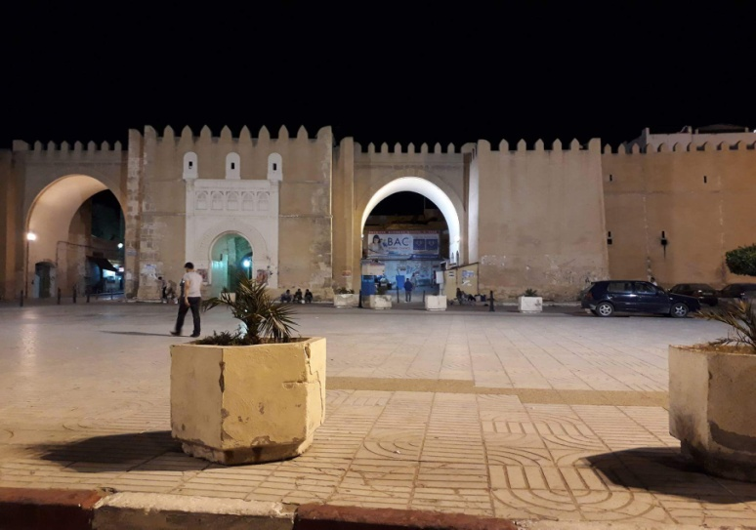
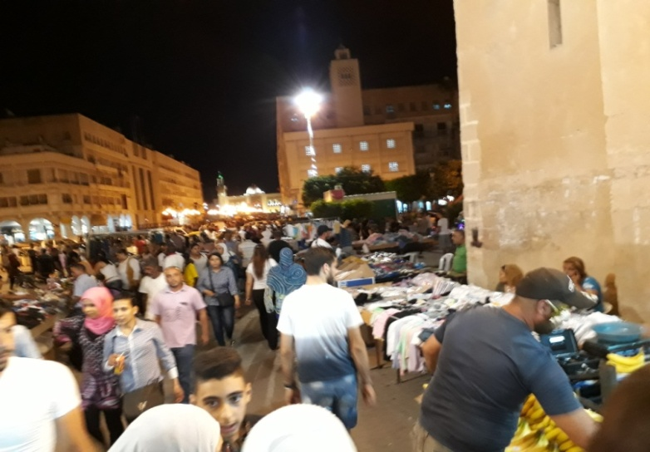
Example of behaviour change on space practices occasionally
The frequentation of city center in ordinary day and in religious festivities

Slide 38
Conclusion
This work pertaining to the use of Sfax city by gender according has shed some light on:
The fact that Sfax city is dynamic by diurnal day time and less frequented by night.
Social time is anchored on spatial cognition by men and women.
Mutation of some space practices from the public sphere to the domestic sphere
The use of space is conditioned by social values and the lack of infrastructure which must serve gender equality.

Slide 39
It’s necessary to reorganize Sfax city bu integrating gender equality in urban politics. Public sphere can be accessible by day and night for men and women.
We can change the vocation of some spaces by illuminating dark places, organizing cultrual events and creation of leisure areas.

